Slide 1

Applying MLP
By: Zach Lanter and Bryan Gutierrez

Slide 2
Dataset & Goal
Adult Income dataset (UCI)
Task: predict whether income >= $50k
32,561 training rows, 16,281 test rows
Same data from Project 1
Notes:
“For our project, we used the Adult Income dataset from the UCI Machine Learning Repository.
The goal was to predict whether a person’s income is greater than or equal to $50,000 per year based on demographic and employment attributes.
The dataset includes about 32,000 training rows and 16,000 test rows, giving us enough data to train and evaluate our models effectively.
We used the same dataset as in Project 1, so this time, we focused more on improving model design and performance.”

Slide 3
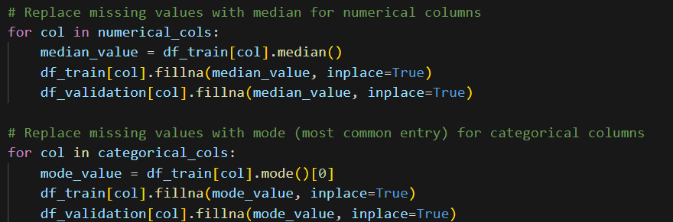
Preprocessing – Handling missing Values
Missing Values:
For numerical columns, replace nulls with the median
For categorical columns, replace missing values with the mode
Notes:
“In our preprocessing step, we focused on handling missing data properly to avoid skewing the model’s learning.
For numerical columns, we replaced missing values with the median. This helps reduce the effect of outliers since the median is more stable than the mean.
For categorical columns, we used the mode, or the most common category, to fill in missing entries.
This ensured that our dataset stayed consistent and complete without introducing any extreme values or bias before training.”

Slide 4
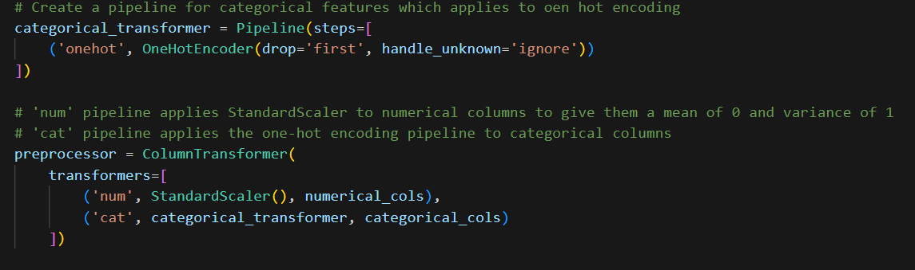
Preprocessing – Categorical Values
To get categorical data able to work with, we created a pipeline for one-hot encoding
To finish the preprocessing, transform all columns to scale
Notes:
“For our categorical data, we needed to convert text-based variables into a numeric format that the model could understand.
To do this, we built a pipeline for one-hot encoding, which turns each category into binary columns — helping the model interpret those features correctly.
After encoding, we applied scaling to all columns so that both numerical and categorical features are on a similar range.
This step ensures the model treats every variable fairly and improves overall training stability.”

Slide 5
Preprocessing – Numerical Values
Transform the income (our target variable) to be binary.
>= 50k income is a 1 and < 50k income is 0
Notes:
“In this step, we focused on transforming our target variable, which is income.
Originally, income was stored as text either ‘>50K’ or ‘≤50K’. To make it usable for machine learning, we converted it into a binary format.
If a person earns more than $50,000, it’s labeled as 1, and if they earn less than $50,000, it’s labeled as 0.
This makes the prediction task a clear binary classification problem, allowing our model to distinguish between higher and lower income groups.”

Slide 6
Performing MLP

Slide 7
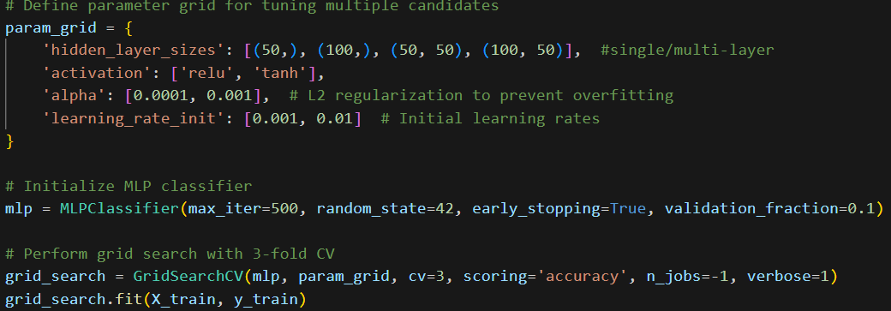
Train and Test while Tuning
Best parameters –
activation: 'relu', alpha: 0.001, hidden layer size: (50,) learning rate: 0.001
Best cross-validated accuracy: 0.8565
Notes:
To find the best model, we used GridSearchCV to test combinations of hyperparameters:
Hidden layer sizes: single layer with 50 nuerons and 100 nuerons and also a multi layer with 50 and 50 and then 100 and 50
Activation functions: ‘relu’ (it outputs zero for any negative input, and passes through positive values unchanged) and ‘tanh’ (useful when you want outputs centered around zero, which can help with convergence)
Perfromed L2 regularization to prevent overfitting
Learning rates: 0.001 and 0.01
The best configuration used ReLU (most likely due to using one hot), alpha = 0.001, hidden layer size (50,), and learning rate = 0.001. This gave us a cross-validated accuracy of 85.65%, which is strong

Slide 8
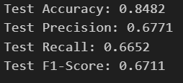
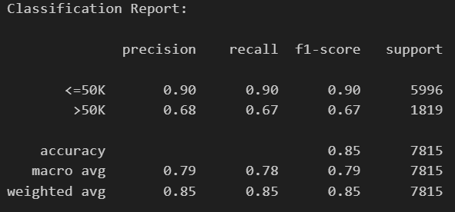
Evaluation
Test Accuracy: Strong overall predictions
Test Precision: Reliable >50K predictions with few false positives
Test Recall: Captures 2/3 of true >50K cases despite imbalance
Test F1-Score: reliable predictions for the >50k class
<=50K Class: High performance (~90 percent)
Model excels at identifying low earners
>50K Class: Moderate (~67 percent)
Balanced detection for minority class despite imbalance
Notes:
Overall, the model is highly reliable for predicting low earners, and moderately effective for high earners. The metrics show a good balance between precision and recall, and the F1-score confirms that the model is robust enough to handle the minority class without overfitting.

Slide 9
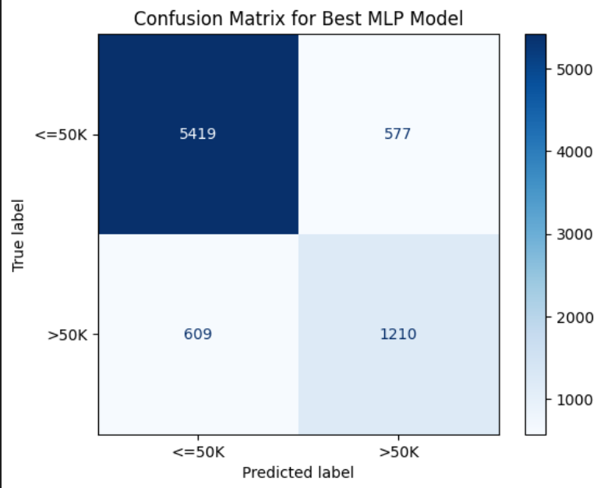
Confusion Matrix
Performs well in True Negatives and True Positives
False Negatives and False Positives are a little high but not alarming
Notes:
The confusion matrix confirms our metrics. We had strong true positives and true negatives. False positives and false negatives were present but not excessive. This balance is important in real-world applications where misclassification can have social or financial consequences.

Slide 10
Why did we choose the specific architecture?
Smaller Networks:
Chosen because the dataset is tabular, so deep architectures weren’t necessary.
Activation Function:
ReLu performed best with one-hot encoded inputs, preventing vanishing gradients.
Model Design Goal:
Balance learning power and generalization while avoiding over-complexity and overfitting.
Notes:
For our model, we decided to use smaller networks because our dataset is tabular meaning the data is structured in rows and columns.
Deep architectures would’ve been unnecessary and could’ve caused overfitting.
For the activation function, we used ReLU, since it worked best with our one-hot encoded inputs and helped prevent vanishing gradients, keeping learning efficient.
Finally, our design goal was to find the right balance strong enough to learn meaningful patterns but simple enough to generalize well and avoid over-complexity or overfitting

Slide 11
How did you monitor and mitigate overfitting in your models?
Hyperparameter Tuning:
Used GridSearchCV with 3-fold cross-validation to find optimal parameters.
Overfitting Prevention:
  Implemented early stopping to monitor validation accuracy.
  Added L2 regularization and limited epochs.
  Used smaller architectures for better generalization.
Final Evaluation:
Model performance was tested on a 30% hold-out set for unbiased assessment.
Notes:
“For this part, we focused on keeping our model accurate without overfitting.
First, during Hyperparameter Tuning, we used GridSearchCV with 3-fold cross-validation. This allowed us to systematically test parameter combinations and find the best setup for performance and stability.
Next, for Overfitting Prevention, we added several safeguards:
We used early stopping to track validation accuracy and stop training when improvement plateaued.
We also included L2 regularization and limited the number of epochs to prevent the model from memorizing the data.
Finally, we kept our architectures smaller to promote better generalization.
For the Final Evaluation, we tested performance on a 30% hold-out set data the model hadn’t seen before to ensure an unbiased and realistic assessment.”

Slide 12
What ethical concerns might arise from deploying models trained on these datasets?
Sensitive Attributes:
Dataset includes variables like race, sex, and marital status.
Bias Concern:
Models may learn unfair or discriminatory patterns toward certain groups.
Mitigation Approach:
Perform fairness checks and consider excluding biased variables when appropriate.
Notes:
When deploying models like ours, ethics becomes a major consideration.
First, the dataset includes sensitive attributes such as race, sex, and marital status. These variables can unintentionally influence predictions if the model learns patterns tied to them.
This leads to a bias concern the model could develop unfair or discriminatory patterns toward specific demographic groups, even if that wasn’t our intention.
To address this, we followed a mitigation approach: we recommended conducting fairness checks to detect unequal outcomes and consider excluding or de-emphasizing biased variables when appropriate.
Overall, the goal is to make sure the model’s predictions remain accurate, fair, and ethically responsible.”

Slide 13
Why are activation functions necessary in neural networks?
Without Activation:
Layers would collapse into a single linear function,
Making the network unable to capture non-linear relationships.
Why ReLU:
Speeds up training through efficient gradient propagation.
Prevents vanishing gradients, keeping learning stable and fast.
Notes:
Activation functions are what make neural networks powerful.
Without them, all the layers would basically collapse into one linear function, meaning the model couldn’t learn any complex, non-linear relationships in the data.
We used ReLU because it’s fast and efficient it speeds up training by keeping gradient flow smooth and also prevents vanishing gradients, which helps the model learn more effectively and stay stable during training.

Slide 14
Thank You

